Slide 1

E-Commerce Analytics
Group Members:
Kannayya Uppalapati
Keerthi Vadithya
Krishanu DasGupta
Lavleen Sehgal
Satish G

Slide 2
Table of Content
Our Objective & Understanding of data
EDA
Model Building
Cluster Analysis
Business Insights
Feature Reduction
Feature Engineering
Variable Analysis
Data Cleaning: Missing Value Treatment
Label Encoding

Slide 3
Our Objective & Understanding of data
Objective : To segment the customers of an e-commerce company by using the RFM approach in an unsupervised learning model.
Understanding of data set
The given data set is the e-commerce transactional data for 4348 customers that contains the date-time of sale, customer shipping location, and price of single unit from 2016 to 2017.
The data records 5,37,979 transactions. The data set has the following variables:
S.No | Columns | Description
1 | Customer ID | This is the unique identifier for each Customer
2 | Item Code | This is the Unique ID for each product
3 | Invoice No | This is the Unique ID for each purchase
4 | Date of purchase | Date on which the purchase was made
5 | Quantity | Number of items bought for each product
6 | Time | Time at which the purchase was made. The time is in IST time zone.
7 | Price per Unit | Price of single unit of item purchased
8 | Price | Total purchase price
9 | Shipping Location | This is the location of the warehouse from where the product was shipped
10 | Cancelled Status | The Status of Cancellation (True/False)
11 | Reason of Return | Reason for the return of products
12 | Sold as set | It states whether the product was sold with another product/ Offer or not
Our Objective &
Understanding of data
EDA
Model Building
Cluster Analysis
Business Insights

Slide 4
Exploratory Data Analysis
Libraries used : NumPy, Pandas, SciKit Learn, Seaborn, Matplotlib
Tools Used: Tableau, Jupyter Notebook
Unique customer with shipping locations: We analysed the no of unique customers at each shipping location. And the top 6 shipping locations are given as below:
S.No | Shipping Location | Unique Count of Customers
1 | Location 36 | 4347
2 | Location 26 | 1886
3 | Location 14 | 1712
4 | Location 15 | 1500
5 | Location 1 | 1032
6 | Location 11 | 976
These locations contribute to 60% of the shipping orders
Missing Value Treatment
S.No | Variables Missing Values | % of data Missing | Missing Value treatment
1 | Customer ID | 25% | Dropped the records as our objective is to classify the customers into segments.
2 | Cancelled Status | 80% | The missing values were replaced by “False” i.e., the order was not cancelled.
3 | Reason of return | 99.9% | The missing values couldn’t be replaced there is no significant data to analyse and replace.
4 | Sold as set: | 99.9% | The missing values couldn’t be replaced there is no significant data to analyse and replace.
Our Objective &
Understanding of data
EDA
Model Building
Cluster Analysis
Business Insights

Slide 5
Feature Reduction
S.No | Variables Dropped | Reason
1 | Item Code | As we do not have the description of the items ordered, we can’t analyse the products in demand.
2 | Reason of return | This variable was dropped as there was no significant data to analyse.
3 | Sold as set | This variable was dropped as there was no significant data to analyse.
Label Encoding
S.No | Variables Encoded | Reason
1 | Cancelled Status | The cancelled orders were marked as 1 and the orders delivered were marked as 0
2 | Shipping Location | There are 20 distinct shipping locations and they have been labelled from 0-19.
Feature Engineering
S.No | Features | Reason
1 | Hour (Time) | The hour when the order placed was extracted from the time stamp to analyse the order placed pattern
2 | Date of Purchase | The date (i.e. 1-31) of the month of order placed.
3 | Month of Purchase | The month of order placed.
4 | Year of Purchase | The year(2016/2017) of order placed.
5 | Recency | It is denoted by how recent the customer’s last purchase was. Recency = Base Date (1st Jan 2018) – Last order date of each customer
6 | Frequency | It is denoted by how often each customer made a purchase in the given period. Frequency = Count of unique invoice numbers of each customer
7 | Monetary | It denotes how much money did the customer spend during the given period. Monetary = Sum of the Total purchase price of each customer
Note: We have assumed that the Date of Purchase column is the date when the customer has placed the order. The base date considered is 1st Jan 2018 as we have transactional data from 2016-2017.
Our Objective &
Understanding of data
EDA
Model Building
Cluster Analysis
Business Insights

Slide 6
Recency, Frequency and Monetary Score Calculation:
The RFM scores are assigned for each customer. The RFM values are divided into 4 segment and rated from 1 to 4. We calculated the quantiles and assigned the values as given below:
Quantiles | R Score | F Score | M Score
25% | 1 | 4 | 4
50% | 2 | 3 | 3
75% | 3 | 2z | 2
100% | 4 | 1 | 1
RFM Group and Score Calculation:
The RFM group score are calculated for each customer by concatenating the values as a string
RFM Score is calculated by summing up the individual R, F and M score.
The RFM scores ranges from 3 – 12. Below is an example for the same:
Customer ID | R | F | M | RFM Group | RFM Score
90 | 1 | 1 | 1 | 111 | 3
876 | 1 | 2 | 2 | 122 | 5
4294 | 2 | 2 | 3 | 223 | 7
2210 | 4 | 4 | 2 | 442 | 10
1432 | 4 | 3 | 4 | 434 | 11
Our Objective &
Understanding of data
EDA
Model Building
Cluster Analysis
Business Insights

Slide 7
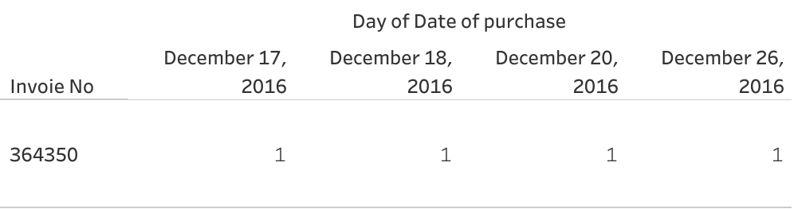


Date of Purchase
The date of purchase given in the data is the date the order is shipped.
As given in the table below, there are multiple date of purchases for a single invoice number.
To calculate the recency and understand the purchasing pattern, we have considered the first date of each invoice for eg: December 17 in the above scenario.
Our Objective &
Understanding of data
EDA
Model Building
Cluster Analysis
Business Insights

Slide 8
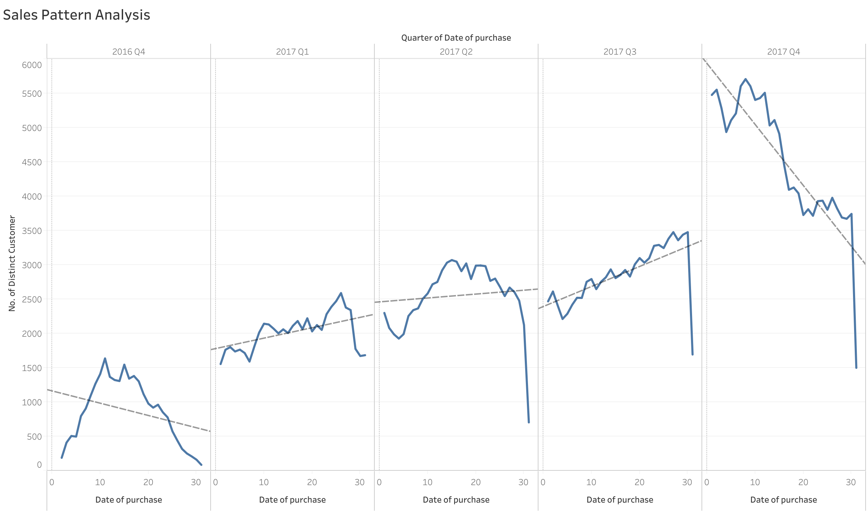

Sales Pattern Analysis
Inferences
The no. of customers are increasing in every quarter.
The no of customers increased rapidly in 2017 Q4
Majority of the new customers join during first 15 days in every quarter and the number decreases towards the end of every month.
The no. of distinct customers per quarter
Our Objective &
Understanding of data
EDA
Model Building
Cluster Analysis
Business Insights

Slide 9
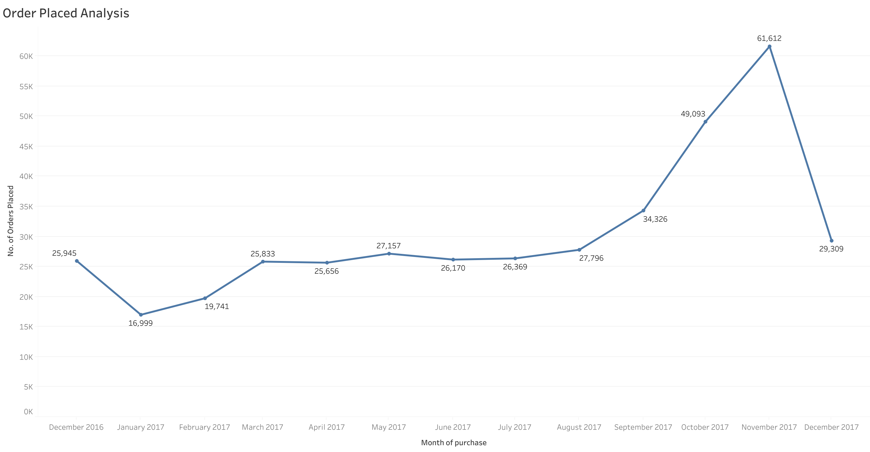
Order Placed Analysis
Inferences
There is a sudden increase in no. of orders placed from September till November.
There is a sudden decrease in no. of orders placed in December
This can be a seasonal effect where the number of orders increases by 50% in Sep, Oct & Nov.
No of orders placed in each month
Our Objective &
Understanding of data
EDA
Model Building
Cluster Analysis
Business Insights

Slide 10
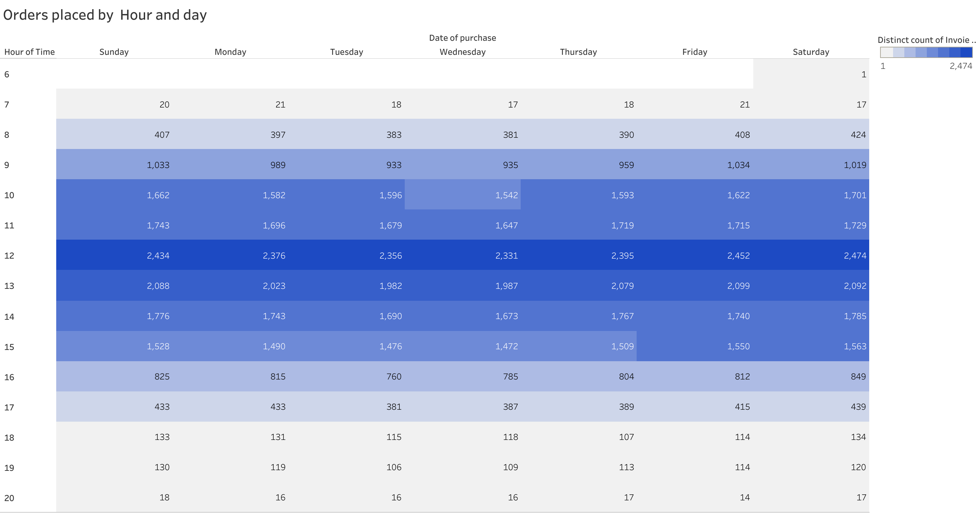
Order Time Analysis
Inferences
In a day, ~92% of orders are placed from 9 AM – 4 PM IST.
The peak hour is 12 PM – 1 PM IST
The no. of orders placed is similar across all days of the week.
Our Objective &
Understanding of data
EDA
Model Building
Cluster Analysis
Business Insights

Slide 11

Model Building
Model #1 - KMeans
Model #2 - PCA + KMeans
To classify the e-commerce customers into different segments based on similarities between them.
The unsupervised technique for clustering is Kmeans.
PCA reduced the dimensionality of the data and represents the multivariate data set as smaller set of variables to observe trends, jumps, clusters and outliers.
Build KMeans on the top of it
Our Objective &
Understanding of data
EDA
Model Building
Cluster Analysis
Business Insights

Slide 12

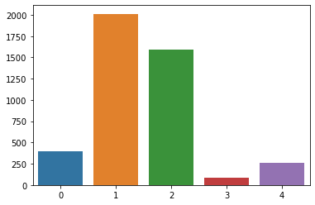
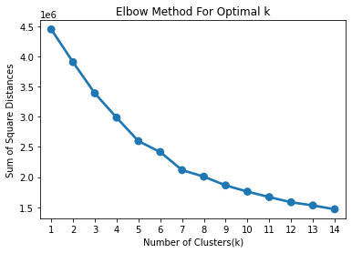
Model #1 – K-Means
Standardization of data
As a pre-requisite to KMeans model, the data is Standardised using Standard Scaler to bring the entire data to same scale for better interpretation.
KMeans Clustering
Using Elbow Method to get the optimal value of K: We calculated the inertia for the clusters ranging from 1 to 10. Below is the Elbow graph (Inertia v/s no. of clusters) for this data set:
The optimal K value is 5 in this model as there is a no significant dec in the sum of squared distance.
We will segment the customers using K Means clustering algorithm. And plot the clusters as given below:
Silhouette Score : The silhouette score for model #1 is 0.27
Our Objective &
Understanding of data
EDA
Model Building
Cluster Analysis
Business Insights

Slide 13
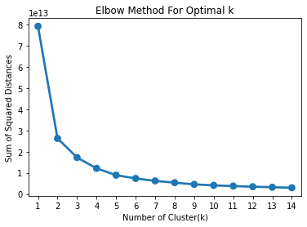
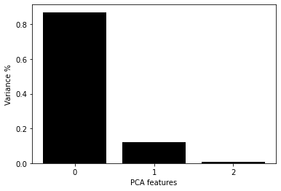
Model #2 - PCA + K-Means
Dimensionality Reduction using PCA (Principal Component Analysis): PCA reduced the dimensionality of the data and represents the multivariate data set as smaller set of variables (summary indices) to observe trends, jumps, clusters and outliers.
The PCA graph indicates, majority of the variance (95%) is explained by PC1 & PC2 together. So, we will take PC1 & PC2 and further build the model on this.
KMeans Clustering
Elbow Curve: Using Elbow Method To get the optimal value of K: We calculated the inertia for the clusters ranging from 1 to 10. Below is the Elbow graph (Inertia v/s no. of clusters) for this data set:
The optimal K value is 3 as there is a no significant decrease in the sum of squared distance.
Our Objective &
Understanding of data
EDA
Model Building
Cluster Analysis
Business Insights

Slide 14
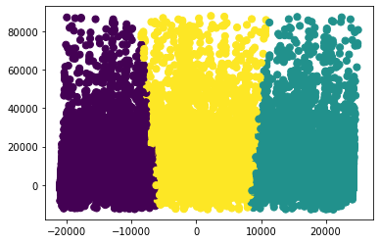
We will segment the customers using K Means clustering algorithm. And plot the clusters as given below:
RFM Centroids: Below are the Recency, frequency and monetary centroids of each cluster
Silhouette Score: The silhouette score for model #1 is 0.52
Cluster 0
Cluster 1
Cluster 2
Clusters/ Centroids | Recency (In Days) | Frequency (No. of purchases) | Monetary (in Rs.)
0 | 32 | 774 | 13,43,820
1 | 80 | 549 | 12,73,320
2 | 53 | 665 | 15,02,850
Our Objective &
Understanding of data
EDA
Model Building
Cluster Analysis
Business Insights

Slide 15



Model Selection
 | Model #1 - K Means | Model #2 – PCA + K Means
No. of clusters | 5 | 3
Silhouette Score | 0.27 | 0.52
Model #2 is a better model due to the following reasons:
Significant increase in silhouette score
The clusters are well defined
Our Objective &
Understanding of data
EDA
Model Building
Cluster Analysis
Business Insights

Slide 16
Cluster Analysis
Clusters | Cluster 0 | Cluster 1 | Cluster 2
No. of Customers | 1162 | 1726 | 1461
Recency Value | Low* | High | Moderate
Frequency Value | High | Low | Moderate
Monetary Value | High | Moderate | High
Customer Segment | Gold Customers | Bronze Customers | Silver Customers
**Please note that low recency indicates a favorable situation.
Our Objective &
Understanding of data
EDA
Model Building
Cluster Analysis
Business Insights

Slide 17
The Silver customers (Cluster 2)
They also purchase round the year, and their purchases too increases from Sep – Nov .
Their most recent transaction was 2 month ago.
The frequency of their purchase is 665 in last one year.
The monetary value is ~15L, which is higher than our gold customers.
They compromise of ~40% of our entire customer base.
We must try to increase the frequency of the orders placed.
The Bronze customers (Cluster 1)
Their purchase round the year has been stagnant.
Their most recent transaction was ~3month ago.
The frequency of their purchase is 549 in last one year.
The monetary value is ~13L, which is as good as gold customers.
They compromise of ~33% of our entire customer base.
We must try to increase the frequency and recency of the orders placed by them.
The Gold customers (Cluster 0)
They purchase round the year, but their purchases increases from Sep – Nov suddenly.
Their most recent transaction was only a month ago.
The frequency of the 774 transactions in the previous year.
The monetary value is ~13.5L
They compromise of 27% of our entire customer base.
We must deliver value by showing then that we value their loyalty.
The Silver customers (Cluster 2)
The Bronze customers (Cluster 1)
The Gold customers (Cluster 0)
**Please note that low recency indicates a favorable situation.
Our Objective &
Understanding of data
EDA
Model Building
Cluster Analysis
Business Insights

Slide 18
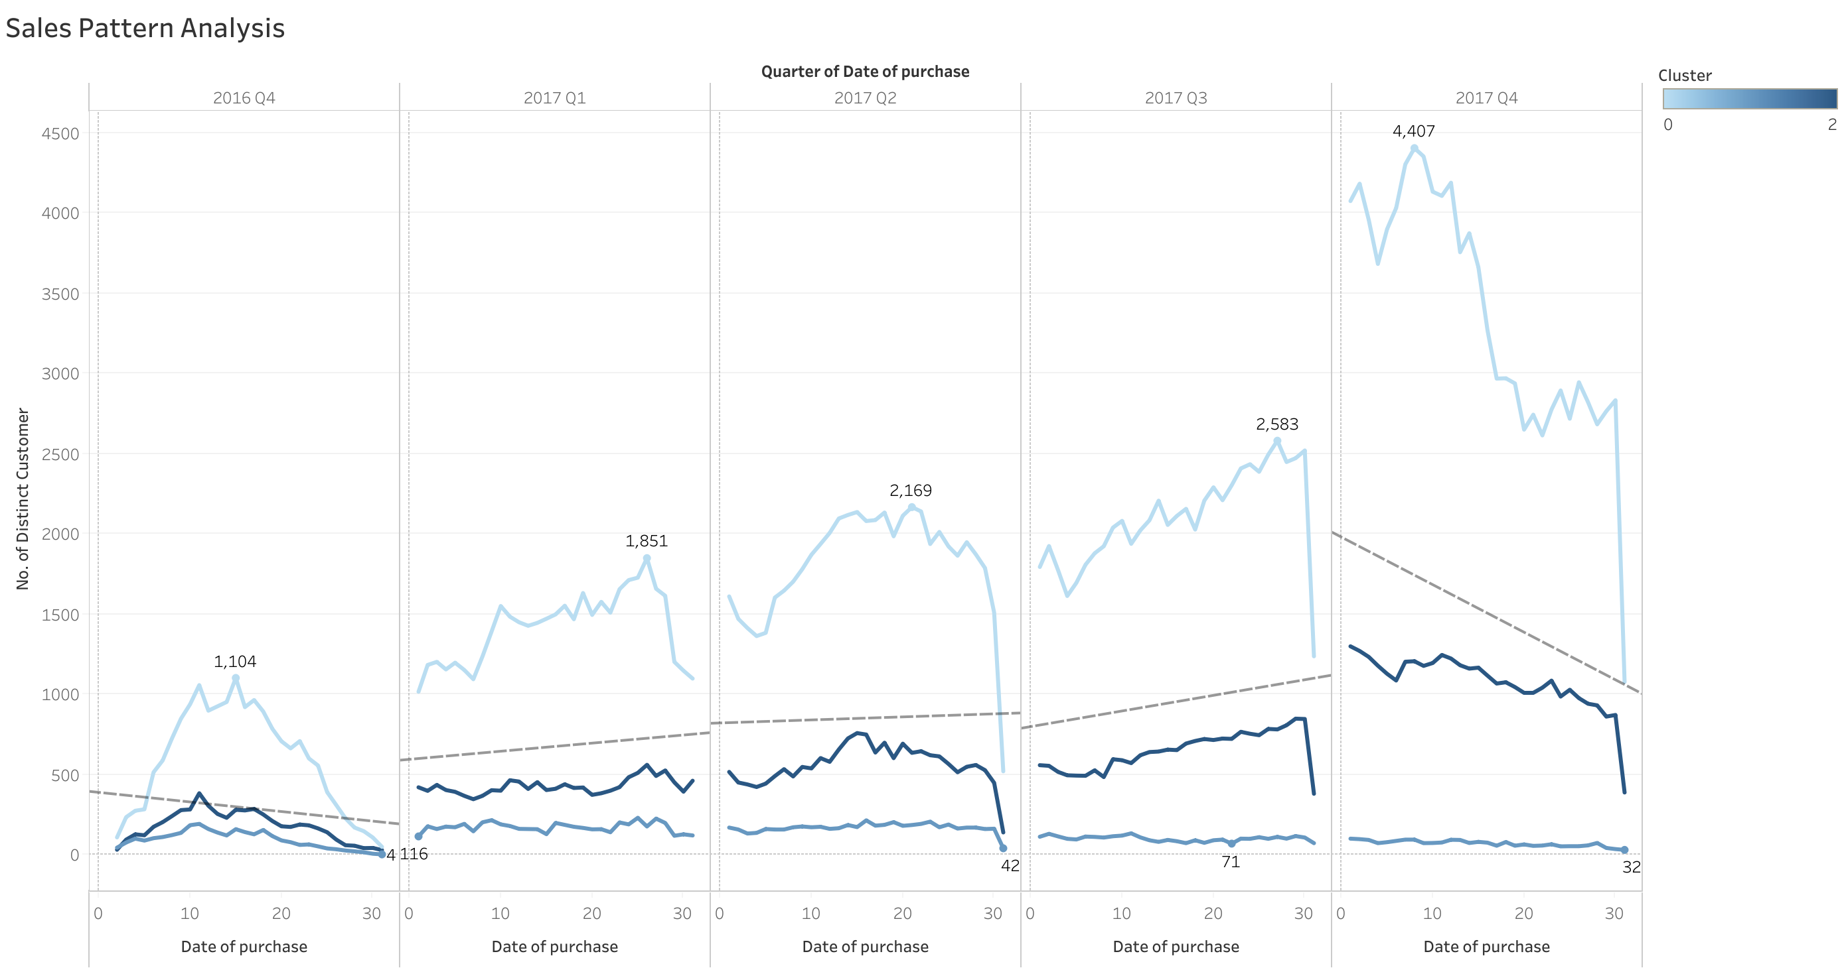
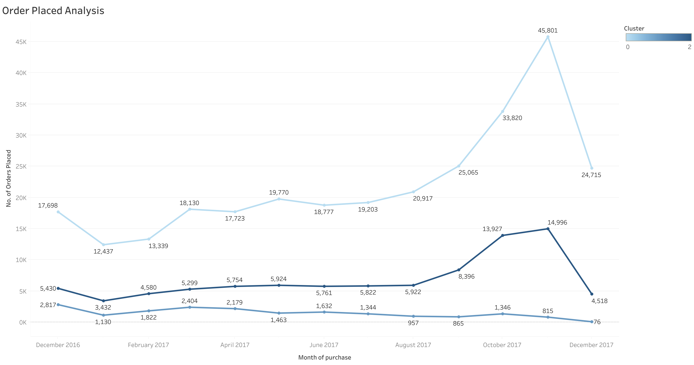
Sales Pattern Analysis
Order Placed Analysis
Gold
Silver
Bronze
The sudden increase in Q4 sales is contributed majorly by Gold customers followed by Silver Customers.
The sales of Bronze customers is constant throughout the year.
The sudden increase in no. of orders placed is contributed majorly by Gold customers followed by silver.
The no. of orders placed by Bronze customers is stagnant throughout the year.
Our Objective &
Understanding of data
EDA
Model Building
Cluster Analysis
Business Insights

Slide 19



Business Insights
We will create a customized promotion strategy for each cluster based on the understanding of the above clusters, as follows:
The Gold customers (Cluster 0): We must not overwhelm them by additional discounts but should deliver value by showing we value their loyalty by the following:
Give early excess to exclusive product launches and sales
Express delivery within a day.
With each purchase we can give triple points as compared to bronze customers that can be redeemed while checking out in the next purchase.
The Silver customers (Cluster 2): We need to increase the frequency and monetary value of this segment. We can accomplish this by the following:
Providing vouchers in the form of cashback (to enable repeat purchases), with a high eligibility threshold (e.g., the voucher is only valid for transaction amount at least Rs.2000).
Free and express delivery on high value orders.
Our Objective &
Understanding of data
EDA
Model Building
Cluster Analysis
Business Insights

Slide 20


The Bronze customers (Cluster 1): Our top priority is to get them transacting more frequently with us as their monetary value is as good as gold customers. We can accomplish this by the following:
We could offer one or two large-benefit vouchers during the slow season Jan- March, with a steady stream of push notifications.
We could offer free delivery for them for all the transactions during Jan- March that would give them a push to order more during slow season.
Followed by benefits like express delivery on high monetary value, that would give them the taste of the benefits offered for gold customers.
Overall Business Suggestion
There can be an email alert for all the customers during the non- peaks hours to encourage them to place the order pending in their cart by offering no shipping cost(if any).This would help spread the orders uniformly across the day for all week.
The orders increase suddenly from Sep- Nov, the company should expand the shipping warehouse during these months and release some of the shipping locations in Jan & Feb.
Our Objective &
Understanding of data
EDA
Model Building
Cluster Analysis
Business Insights

Slide 21
Thank You

